Slide 1
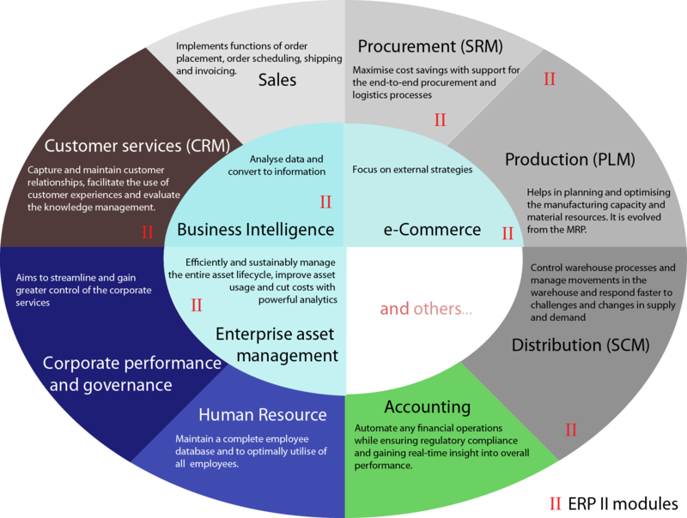
WHAT IS ERP?
Enterprise resource planning (ERP) is the integrated management of core business processes, often in real-time and mediated by software and technology
It’s a Business-Management Software.

Slide 2
Features of erp
An integrated system
Operates in (or near) real time
A common database that supports all the applications
A consistent look and feel across module
ERP systems track business resources Cash, Raw Materials, Production capacity and the status of business commitments: Sales orders, purchase orders, and payroll.

Slide 3
Functional Areas of erp
Finance & Accounting, General Ledger, Fixed Assets payables including vouchering, matching and payment, receivables Cash Management and collections, Financial Consolidation
Management Accounting Budgeting Costing, cost management activity based costing
Human resources: Recruiting training, rostering payroll benefits retirement and pension plans diversity management retirement separation
Manufacturing: Engineering bill of materials work orders, scheduling capacity workflow management, quality control, manufacturing process, manufacturing projects, manufacturing flow, product life cycle management
Order Processing: Order to cash, order entry, credit checking, pricing, available to promise, inventory, shipping, sales analysis and reporting, sales commissioning.

Slide 4
Functional Areas of erp (Cont..)
Supply chain management: Supply chain planning, supplier scheduling, product configurator, order to cash, purchasing, inventory, claim processing, warehousing Project management: Project planning, resource planning, project costing, work breakdown structure, billing, time and expense, performance units, activity management
Customer relationship management: Sales and marketing, commissions, service, customer contact, call center support — CRM systems are not always considered part of ERP systems but rather Business Support systems (BSS).
Data services : Various "self–service" interfaces for customers, suppliers and/or employees

Slide 5
Advantages of erp
Sales forecasting, which allows inventory optimization.
Chronological history of every transaction through relevant data compilation in every area of operation.
Order tracking, from acceptance through fulfillment
Revenue tracking, from invoice through cash receipt
Matching purchase orders (what was ordered), inventory receipts (what arrived), and costing (what the vendor invoiced)

Slide 6
Disadvantages of erp
High ERP switching costs
Extensive training requirements take resources from daily operations
Customization can be problematic

Slide 7
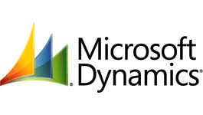

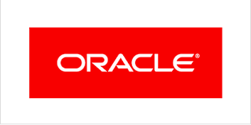
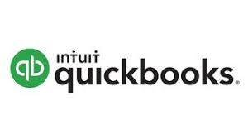

ERP SOFTWARES
Microsoft Dynamic
SAP ERP
ORACLE
QUICKBOOKS
TALLY ERP 9

Slide 8
SYSTEM, APPLICATION & PRODUCT
SAP ERP is enterprise resource planning software developed by the German company ”SAP SE”
SAP was started in 1972 by five former IBM employees with a vision of creating a standard application software for real-time business processing
The company has over 335,000 customers in over 180 countries
Forbes 2016 list of "The World's Biggest Public Companies," SAP was ranked the third-largest software and programming company, behind Microsoft (1) and Oracle (2)
Since 1996, the company has made more than 60 acquisitions
The original idea for SAP was to provide customers with the ability to interact with a common corporate database for a comprehensive range of applications in real time.

Slide 9
Sap products and applications
In 1973, SAP released R/1: a financial accounting system
In 1979, SAP released R/2 :a mainframe system that provided real-time data processing across accounting, manufacturing, supply chain and human resources R/2 helped power SAP's growth, and the vendor expanded its customer base to about 200 companies.
In 1992, SAP released R/3:which represented a switch from mainframe computing to the client-server model, and from a two-tier to a three-tier architecture R/3 was a critical product for SAP that launched the company onto the world stage.
In 1999, SAP launched mySAP, which marked a new strategy for the company of focusing on combining e-commerce software with the applications in R/3
In 2004, the company launched SAP NetWeaver,
In 2006, the company claimed hefty revenue from SAP Business All-in-One and SAP Business One, its SAP ERP systems for SMBs

Slide 10
Sap products and applications
In 2009, SAP Business Suite 7 became available to customers worldwide. At the time, SAP called it "the company's next-generation software suite enabled by service-oriented architecture
In 2011, the company launched SAP HANA, an in-memory database platform.
in 2015, released S/4HANA, an ambitious rewrite of Business Suite optimized for the HANA platform.
ECC is the on-premises version of SAP, and it is usually implemented in medium and large-sized companies. For smaller companies, SAP offers its Business One ERP platform

Slide 11
SAP's functional modules include
Human Capital Management (HCM)
Production Planning (PP)
Materials Management (MM)
Project System (PS)
Sales and Distribution (SD)
Plant Maintenance (PM)
Financial Accounting (FI)
Quality Management (QM)

Slide 12
Course OUTLINES
SAP Business One Installation and Virtualization
Financial Setup (Chart of Accounts, Default G/L Accounts, Multiple Branches, and Currencies)
Financial Process (journal entries, posting periods, and internal reconciliation)
Banking Processes (handling payments and reconciliation of account statements)
Controlling reports (financial and cash management reports)
Fixed Assets Management and Reporting
Financial Controlling Processes (cost accounting and budget)
Logistics (Purchasing Sales, Items, Inventory, Pricing)

Slide 13
Course OUTLINES CONT….
Production Planning, Production Management and Reporting
Administration & Human Resource Planning (HR)
SQL Database Management, Backup and Recovery
SAP-EXCEL integration and SAP Reporting in EXCEL
Implementation tools for setting up and configuring company databases
Customization tools for adding queries, alerts, approval procedures, and user-defined fields & tables
SAP Support tools and processes

Slide 14
Course OUTLINES CONT….
Plan in Excel with the upload of plan data to the SAP System
Run SAP directly from Excel as user interface
Create flexible data aggregations using pivot tables
Calculate margins and other common ratios using calculation on pivot table
Filter data using slicers in multiple pivot tables
Create aggregate reports using formula based techniques
Validate data to restrict the type of data inputs
Consolidate data from a number of different ranges into one new range
Password Protect a Workbook, Worksheet & Ranges
Track changes. Accept and reject changes.
Record Macros, Add Macros to Quick Access Toolbar

Slide 15
Good luck!

